Slide 1
WhiteHatJr Intro Deck
Update: Oct 15th

Slide 2
Agenda
1 | Company Vision & Impact
2 | Business Deep-Dive
3 | Growth Plans
4 | Next Steps

Slide 3
In <12 months, WhiteHat Jr has grown to ~$450K/Month MRR; growing exponentially month-on-month with massive untapped demand
Registrations (#)
Gross Receipts ($ ‘000)*
*Assuming $1=₹70; Amount includes GST

Slide 4
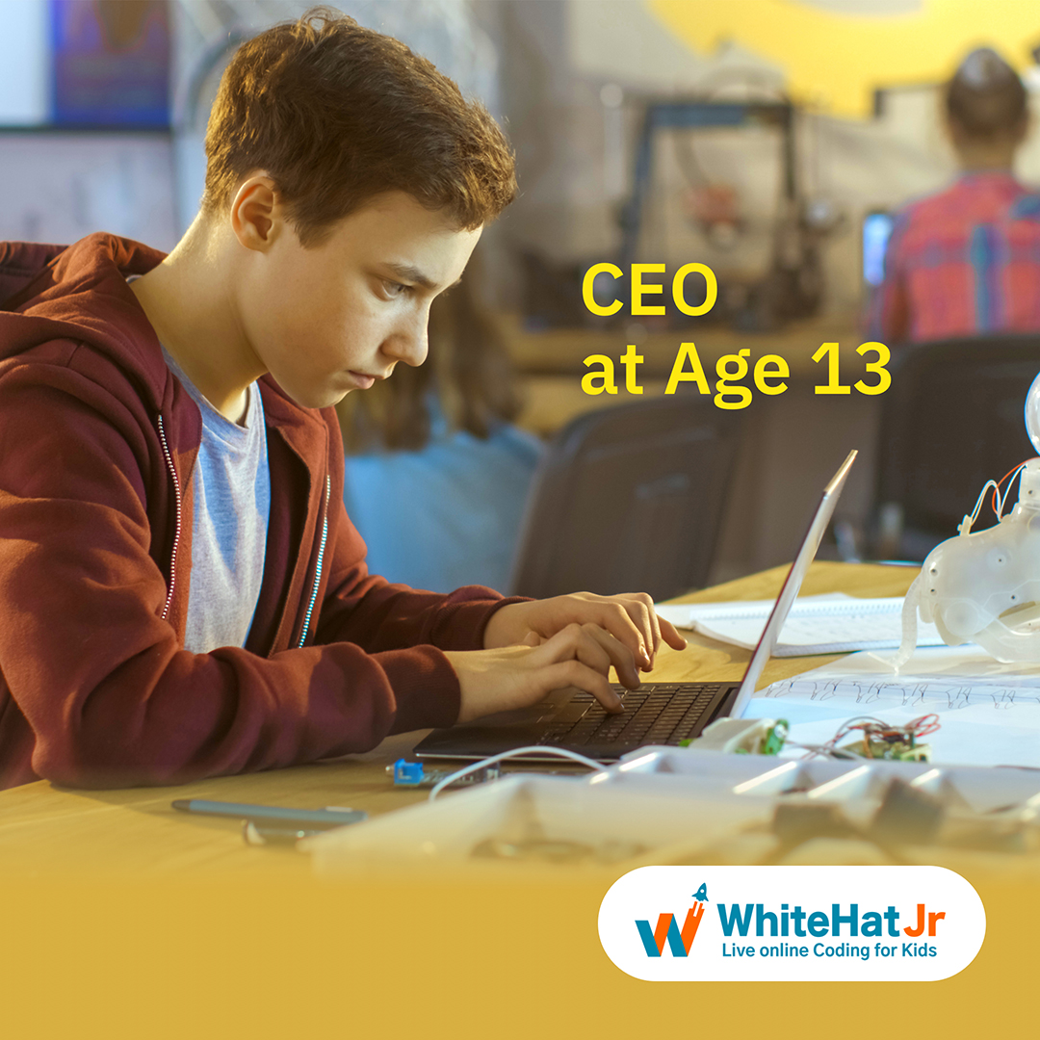



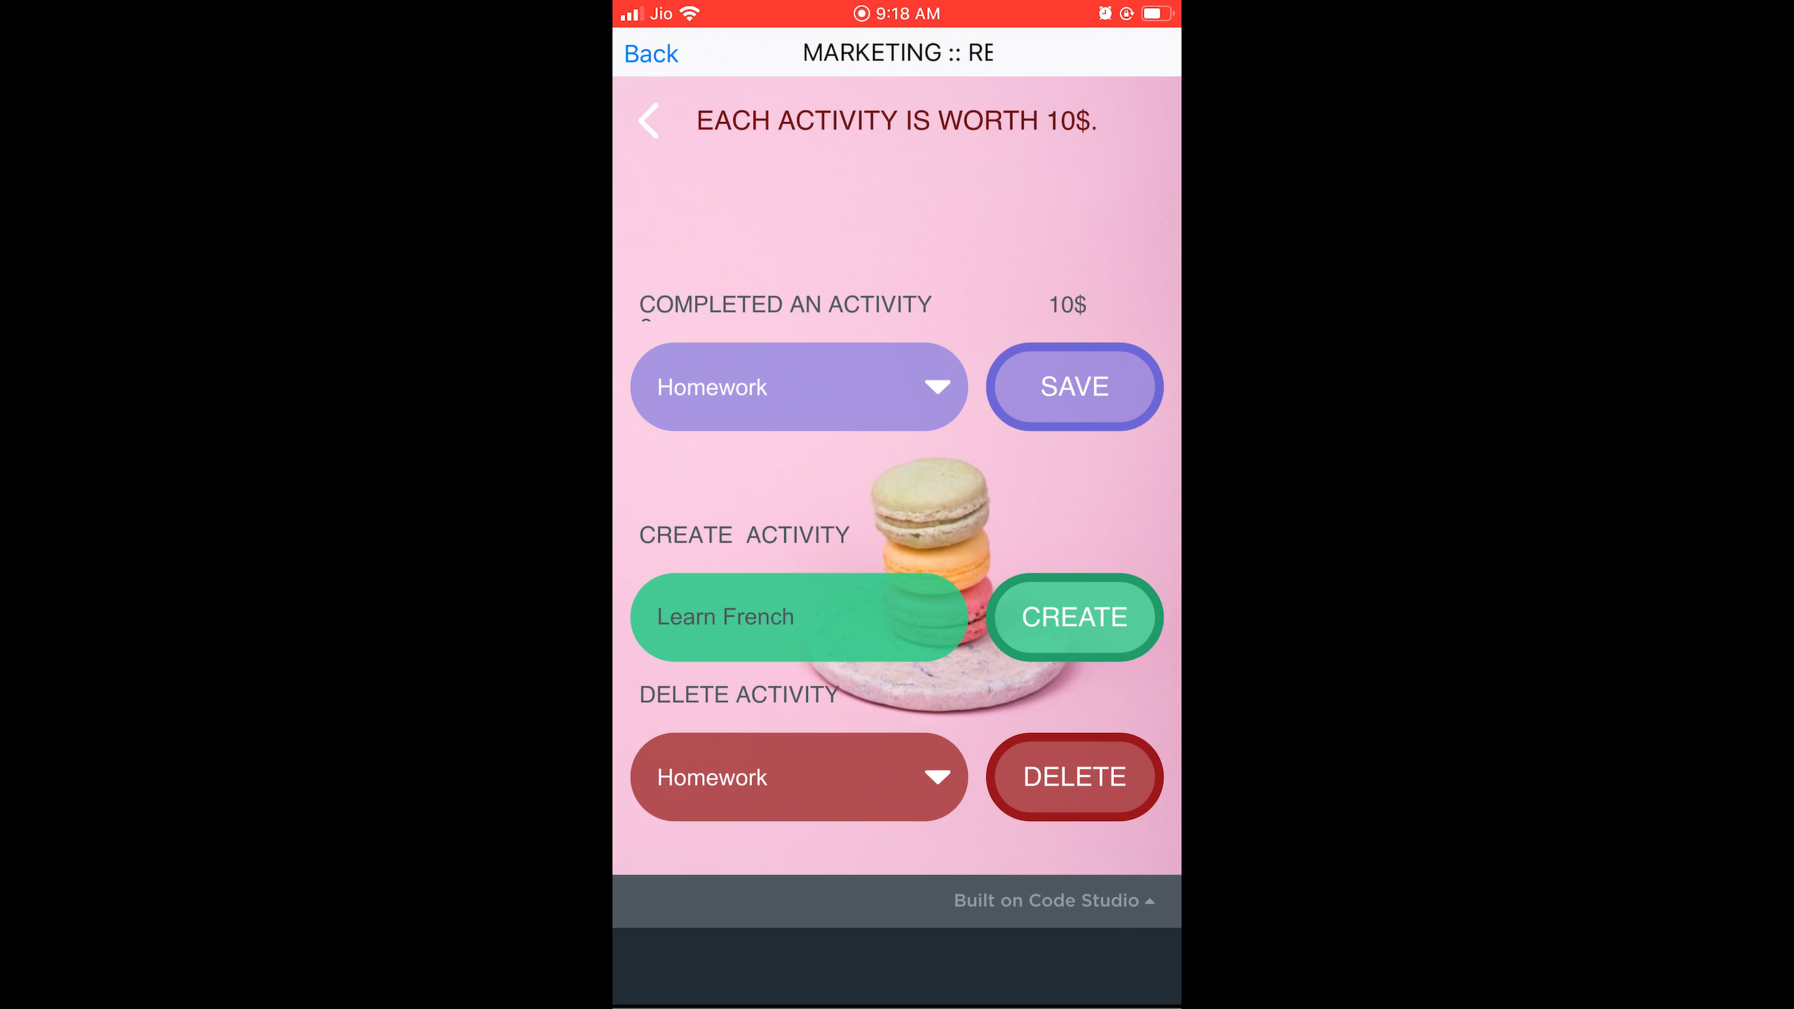
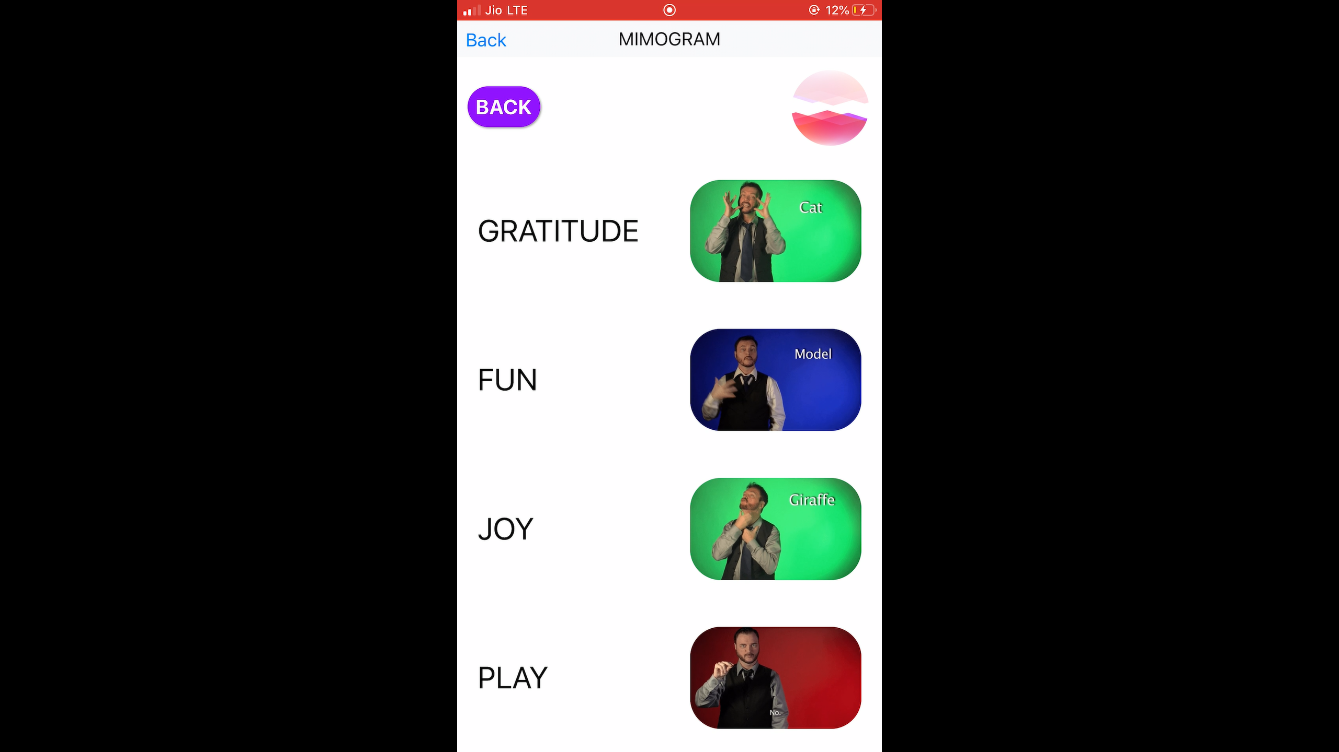
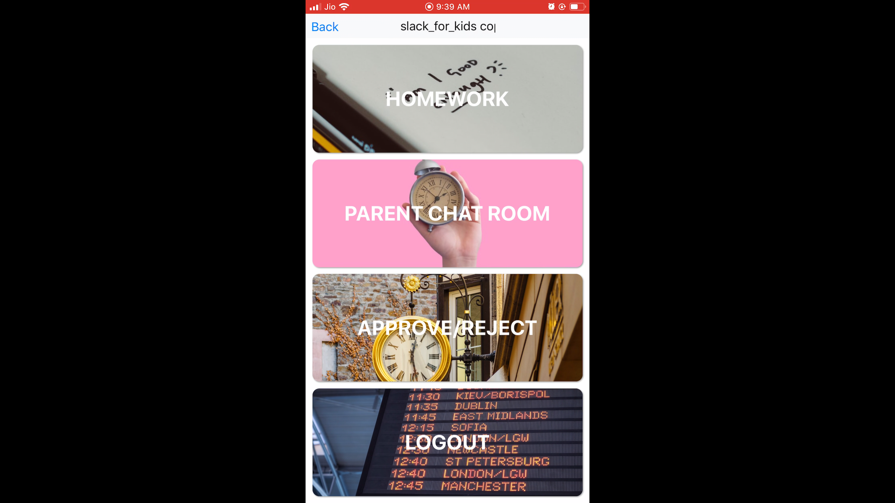
Vision: Enabling a generation to Create versus Consume
VISION
IMPACT
Venkat Raman, Age 6
Hirannya Rajani, Age 7
Shaurya Sharma, Age 12
Reward Management System
Sign Language for hearing Impaired
Communication App for schools

Slide 5
3-Pronged Rapid Category Creation Strategy: (1) Extreme Parent Value (2) “Wow” Kid Delight (3) Teacher Excellence
Inspiring a generation to
CREATE V/s CONSUME
3- Year Plan: 400K Students; $150MM+ ARR.
“BIG & OBVIOUS” PARENT VALUE (Category Leading Conversion:15%+)
“WOW KID DELIGHT”
CURRICULUM (Student NPS: 70+)
“99.9th Percentile”
TEACHER EXCELLENCE
(Teacher NPS: 70+)
01
02
03
Immediate, Urgent Tangible Academic/Career Value for Parents
Context Setting: 95%+ Jobs will change in 7 years time.
“Big & Obvious” Creation Hooks: #1 Game Developer at Age 7; CEO at Age 13; Space Scientist at Age 12.
Proven Academic Value: +300% Improvement in Concentration; +75% Improvement in Logic.
Kid “Wow” Delight in every class
In-Class Wow: (i) Daily Creation eg Apps, Animations, Space Tech Simulations.
Post Class Daily Addictive Engagement: (i) Post-Class Projects (ii) Gamification/Community (iii) Social Celebration
Top 99.9th Percentile Teachers:
Transforming Non-Coders into Coders with Rigorous vetting, training and LMS.
Continuous Conversion and Feedback Training
Deep Teacher Engagement Community.
Deep Tech Enabled Foundation: “Tech that enhances parents understanding of their kids”
Foundation: (i) Low Connectivity Video Solution; (ii) Global Scheduler; (iii) Tech Ops Automation
Delighter: Visual AI for deep parent feedback

Slide 6
Significant Global Whitespace: India among toughest markets for model yet WhiteHat Jr product adoption fastest in India Ed-Tech
Broadband Avg. Speed (Mbps:):
#70 out of 186
Fixed Broadband Subscribers(MM): Lower Penetration vs Major Economies
Laptop/Desktop Penetration (%):
Lower versus other markets
Reliance FTH set to explode Indian Market; Global attractive ”Kids Creation” Whitespace
Source: Statscounter, Statista, Speedtest.net

Slide 7






Curriculum & Teacher Iteration Represent Massive First-Mover Advantage over Substitutes
Curriculum: 1st-of-a-kind CREATION-ORIENTED enabling peak kid imagination
Top 99^{h} Percentile Teacher-Assisted: <5% Kids Identify as Self-Learners
Introduction to Coding
Online Applicants
100
Phone Qualification
20
Interactive Game Design
Demo 1
7
Demo 2
3
PlayStore App
Demo 3
2
System Upgrade
1.5
Space Tech
Conversion Training
1.5
Artifical Intelligence /Data Modeling
30 Day Audit/
Feedback
1
X SCHOOLS
X VIRTUAL CODING
CLASSES

Slide 8





Overall Year 1 Learning Summary: Far-Wider Market than Anticipated
WhiteHat Jr Prop= KID-DELIGHT + PARENT ACADEMIC VALUE
=attracted broad-based segments
Competitive / Test Prep Market
1st Grade
8th Grade
12th Grade
Initial Market Hypotheses– future academically inclined parents
Pitch: “300% Concentration Improvement
75% Logic Improvement”
Other Kids
(Non Test-Prep)
New Market: Pro-Course(7th-9th Grade) seeing Massive Interest from non-JEE academically inclined
Pitch: 1st Structured AI Course for Kids—”21 year olds getting $1 MM straight out of college”
Blue Ocean to launch for 9th-12th eg Data Science
New Market: Significant Interest from “creatively” inclined parents
Pitch: “Your kid will become a creator for life”—Novelist, Artist, Entrepreneur
Consumer Tech at center of household ~ massive interest in value prop

Slide 9
Agenda
1 | Company Vision & Impact
2 | Business Deep-Dive
3 | Growth Plans
4 | Next Steps

Slide 10
Business Summary: All key metrics exceeding Series A Plan significantly; Positive Unit Economics with immediate upside
Performance. Vs Plan
Actual Per Class Unit Economics (₹)*
 | Sep Actual Run Rate | Sep Plan | Index vs Plan
Revenue Run Rate Per Month($) | $335k | $230k | 146
ARPU | $386 | $191 | 202
Renewal (%) | 50% | 50% | 100
Total Revenue (Jan-Sep ‘19) | $1.06M | $0.7M | 151
NPS | 50 | 61 | +11pp
554
70
CAC= ₹71
Gross Margin= ₹175
GM : CAC Ratio=2.4
308
175
52
71
52
Immediate Improvement Drivers eff Dec 1st
Global Pricing
Basic Ops Automations
New Channels Launch: School, Alliances
Note: (i) All numbers are based on collections from sale of packages, and include GST Sep Plan numbers are based on Month-1 from the receipt of Series-A funding (ii) *CAC includes all performance marketing, lead generation, teacher trial, call-center and sales team cost

Slide 11
Consumer Summary: Strong NPS, growing month-on-month, both student and teacher at 60+
STUDENT NPS: 61
TEACHER NPS: 69
(50 in May’19)
(56 in May’19)
Teacher Quality Topmost Positive Driver
Teacher Ops Topmost Positive Driver
 | NPS | Survey # of Responses
Beginner | 63% | 73
Intermediate | 67% | 165
Advanced | 60% | 243
Professional | 65% | 142
Total | 61% | 623
 | NPS | Survey # of Responses
Beginner | 64% | 23
Intermediate | 70% | 44
Advanced | 67% | 65
Professional | 69% | 34
Total | 69% | 166
Student NPS Improvement Drivers in Progress (Dec 1st Goal: 70)
Teacher NPS Improvement Drivers in Progress (Nov 1st Goal: 90)
CLASS SCHEDULING/OTHER TECH
POST CLASS PROJECTS
CLASS SUMMARIES/FEEDBACK
SLOT SCHEDULING
TEACHER TRAINING
TEACHER REWARD & RECOGNITION

Slide 12
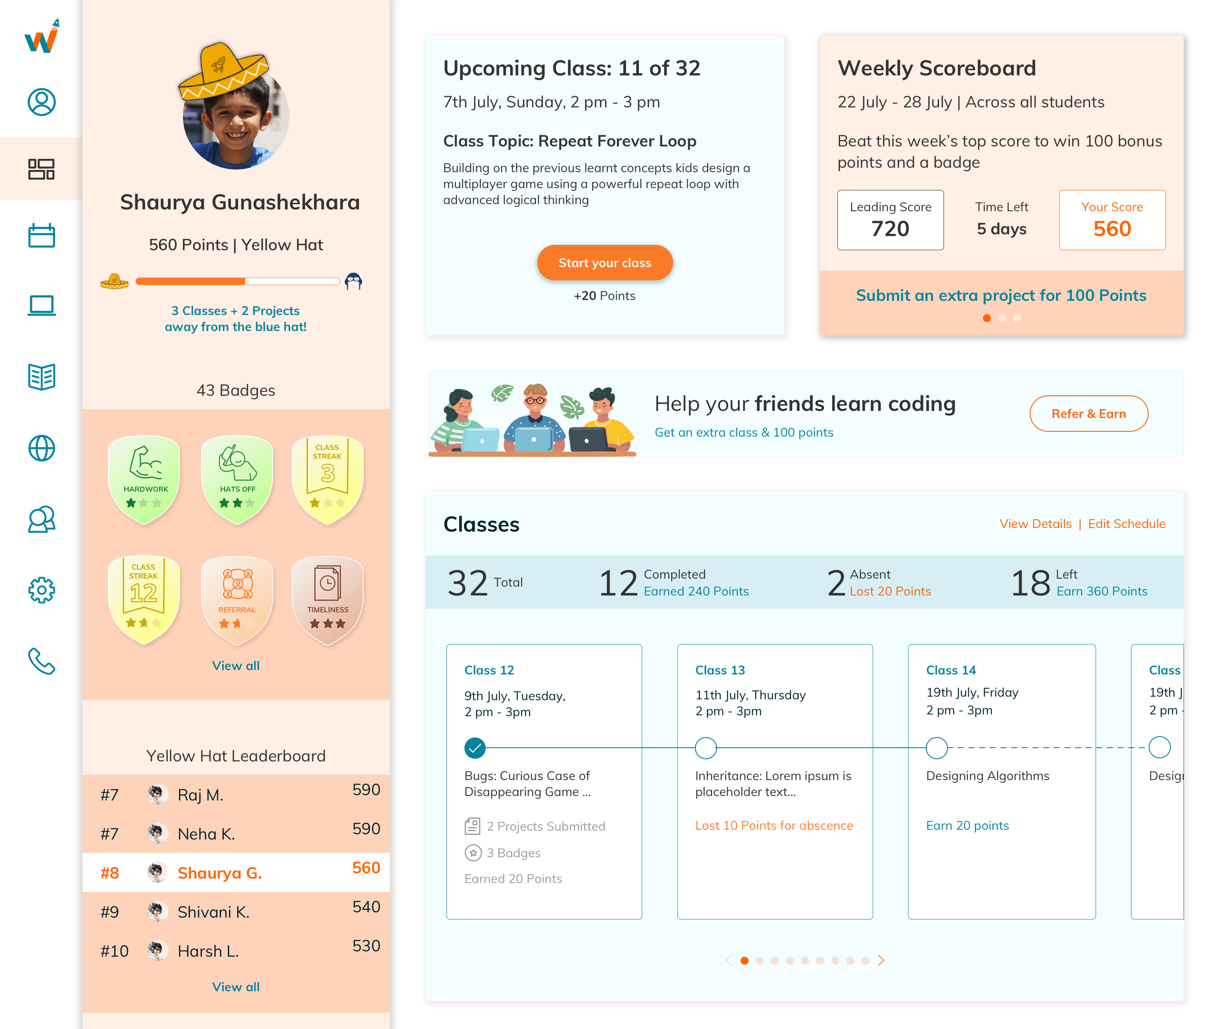









V2 Tech Launch expected to step-change consumer engagement: Gamification, Community, Massive UI/UX overhaul

Slide 13
Agenda
1 | Company Vision & Impact
2 | Business Deep-Dive
3 | Growth Plans: India, Global
4 | Next Steps

Slide 14
WhiteHat Jr Current User Base fairly dispersed; Immediate India Market Size Projecting Existing Base=$4.5 BN+
Current User Base ~ Avg. School Spend Rs. 60k, Diverse across Professions & School Boards
Income Split: ~75% above 60k
Profession Split: <30% IT
Board Split: ~80% CBSE/ICSE
<Rs 30,000
Homemaker
5%
CBSE
Others
Rs 30,000 - Rs 60,000
IT Professional
4%
IB
State Board
Rs 60,000 - Rs 1 lakhs
Non IT Professional
ICSE
>Rs 1 lakh
Self-employed/Business
METHOD 1: 6-17 urban HH’s with PCs & fixed broadbands
METHOD 2: 6-17 urban HH’s paying > ₹60k in school fee
METHOD 3: 6-17 urban HH’s with Rs 20Lakhs+Disposable Income
HHs having PCs
Kids going to School
Elite Households earning ₹20 Lakh/Year
60 Mn
73 Mn
HHs having Fixed Line Internet
Kids with annual spending on school
9 Mn
17.1 Mn HHs
= 45 Mn kids with PCs
Schoolkids > ₹20 Lakh HH income
> ₹60k
< ₹60k
6-17 yr. old kids (Grades 1-12)
Total Population Size
6.5 Mn
66 Mn
+
6.5 Mn
+
~2.2 Mn*
8.1 Mn
~2.5 Mn*
Market for White Hat
13 Mn
~9 Mn
10-11 Mn

Slide 15
WhiteHat Jr Teacher Profile: <35, Female, Diverse Education Background: scales to ~2MM+ Teachers
Current Teacher Base ~ <35, Full-Time, Diverse Education Background
Immediate Supply Pool: 1.8MM+ vs 3-Year Supply Needs 44k
Age Split: 80% <35
Selected Courses | Est. # of <35 yr Females |  | Est. pool with B2+ language skills*
UG in Arts, Commerce, Education & Management | 11 M | x 10% | 1.1M
UG / PG in Science disciplines | 2.2 M | x 15% | 0.4L
UG / PG in Computer Applications and Engineering | 1.3 M | x 25% | 0.3M
Total Supply Pool | 14.5 M |  | 1.8MM
Less than 23
31 to 35 years
4%
23 to 26 years
More than 35
27 to 30 years
Backgrounds: Mix of Tech & Non-Tech but limited prior coding experience
BTECH/MTECH
BCA/MCA
BE/ME
MBA/LLB
BSC/MSC
Others
Profession Split: Split between full-time and part-time
WhiteHat Jr Teacher Needs
Fulltime WhiteHatJr
Y1 | Y2 | Y3
3,343 | 6,852 | 44k
WH + Education
WH + 2nd job

Slide 16
WhiteHat Jr Very Attractive Financial option for Teachers enabling strong talent pool
Class
Paid Students
Average pay
1
TRIAL
Guaranteed Pay for opening 160 slots
Rs 10,000
Conversion Incentive Rs 500/sale
(Rs. 500 x 12)
Rs 6,000
Month
Total
10
12
100% TRIAL
40% N0-shows
10% N0-show Tech
50% Completed Classes
100%
Total Pay: Rs 16,000
2
Total
Paid Students 12 students x 8 classes/month x Rs 275/class)
Rs 26,400
Trail Class Fee 64 students x Rs 50/class)
Rs 3,200
Conversion Incentive Rs 500/sale
(Rs. 500 x 8)
Rs 4,000
Month
12
8
TRIAL
PAID
+
50% TRIAL
New paid student
50% PAID
50%
Total 20
Total Pay: Rs 33,600
Paid
Paid Students 20 students x 8 classes/month x Rs 275/class)
Rs 44,000
Month
3
Total
20
100% PAID
100%
Total Pay: Rs 44,000
*Assumes 40 hrs/week teaching = 40 hrs slots of Max 49 hrs Slots. Earnings may go up or down depending on doing more or less than 40 hrs slots.
*WhiteHat re-imburses Teachers Internet Upgrades upto Rs. 2,000/month

Slide 17
Expansion Plans Testing eff Dec 1st: Test Global 1:1; Test 1-to-2 India Product
India | Current Market
9m x $500/student/yr = 4.5Bn
India | 1-to-4 Market
26m x $315/student/yr* = 8.2Bn
US | Current Market
19m x $1500/student/yr = 28.5Bn
1-to-1 Coding Global (starting with SEA)
New
Only US: ~$28 Billion Market
Market
1-to-1 Coding India
1-to-2 India Coding Product
$8-9 Billion* Market
Existing
$4-5 Billion Market
Existing
New
Product
* Wtd Avg Fee, details in slide x
Assumption: about 50% of current market will opt for 1-to-1 and remaining will migrate to 1-to-4

Slide 18














New Market: US, Japan, UK represent most favourable markets to enter~$75 B
Country (or dependency) | # of kids (6-17) (in Mn) | Addressable # of Children | Avg. Wireline Internet Speed (Mb/s) | # of Wired Internet users (Mn) | # of Pc Users (in Mn) | Per Capita Income | Class Price Point | Rev Pot. (in Bn) | Rev. Pot Indexed | Category Tailwinds | Weighted Average Score | Overall Rank
United States | 4,798 | 1,919 | 25.86 | 293 | 459 | $65,058 | $21 | $28.2 | 10.0 | 8 | 9 | 1
India | 34,643 | 5,196 | 6.5 | 560 | 493 | $2,305 | $7 | $25.5 | 9.0 | 10 | 9 | 2
China | 19,355 | 2,903 | 7.6 | 829 | 501 | $10,946 | $7 | $14.2 | 5.0 | 6 | 5 | 3
Japan | 1,298 | 519 | 24.3 | 119 | 104 | $42,271 | $21 | $7.6 | 2.7 | 8 | 4 | 4
UK | 910 | 364 | 13.0 | 63 | 69 | $45,141 | $21 | $5.4 | 1.9 | 8 | 4 | 5
Indonesia | 5,226 | 784 | 7.5 | 143 | 49 | $4,277 | $7 | $3.8 | 1.4 | 8 | 3 | 6
Germany | 853 | 341 | 15.3 | 79 | 74 | $53,577 | $21 | $5.0 | 1.8 | 6 | 3 | 7
Philippines | 2,684 | 403 | 5.5 | 67 | 23 | $3,291 | $7 | $2.0 | 0.7 | 8 | 3 | 8
Mexico | 2,733 | 410 | 7.5 | 85 | 54 | $9,711 | $14 | $4.0 | 1.4 | 6 | 3 | 9
Vietnam | 1,786 | 268 | 9.5 | 64 | - | $2,719 | $7 | $1.3 | 0.5 | 8 | 3 | 10
Thailand | 965 | 145 | 16.0 | 57 | - | $7,504 | $7 | $0.7 | 0.3 | 8 | 3 | 11
France | 925 | 370 | 10.8 | 60 | 58 | $46,732 | $21 | $5.4 | 1.9 | 4 | 3 | 12
Brazil | 3,753 | 563 | 3.6 | 149 | 138 | $10,626 | $7 | $2.8 | 1.0 | 6 | 2 | 13
Russia | 1,813 | 272 | 11.8 | 110 | - | $12,191 | $14 | $2.7 | 0.9 | 6 | 2 | 14
# of kids (6-17) = % of 6-17 age population X Population (2019)
Addressable kids = # of kids (6-17) X 40% for developed mkts, 15% for developing mkts
Avg. Wireless Internet speed: https://www.speedtest.net/global-index
# of wired Internet users: https://www.internetworldstats.com/top20.htm
# of PC users: # of HH X PC per HH
Per Capita Income: http://worldpopulationreview.com/countries/countries-by-gdp/
Rev. Potential = Addressable kids X Price Point / class; broken in 3 tiers depending on GDP / Capita
GDP Growth rate (%): http://statisticstimes.com/economy/projected-world-gdp-ranking.php
Category Tailwinds is subjectively derived based on awareness, adoption, cultural priorities, competition etc. in that region
Weighted Average Score = 70% wt to Revenue Potential Index and 30% to Category Tailwinds

Slide 19
New Product: 1-to-2 will enable access to <60K segment significantly expanding revenue potential
Current Product Environment
New Product Environment
(1-to-1 Offering)
$500/student/yr
(1-to-4 Offering)
$250/student/yr
(1-to-1 Offering)
$500/student/yr
Even with new 1-to-2 product, we expect about 50% of current high-fee market will continue with 1-to-1 model, while remaining will transition to lower fee 1-to-4 model
The lower fee model enables ~30% of the <60k fee market to adopt the product
6.5M
6.5M
3.2M
3.2M
66M
2.2M
19.8M
Total Student Size
8.7M
3.2M
23M
Total Market Size
~$4.4Bn
~$2.2Bn
~$6Bn
~$8.2Bn

Slide 20






Extremely Strong, Committed Management Team with 0% Attrition since inception: Ex IIT/Blue Chip
Curriculum Team:
Computer Science + Early Childhood Experts
Karan Bajaj
(CEO, Founder)
Pranab Dash
(CTO)
Gauri Parulkar (Beginner)
Computer Engineer; Founder, Kids Science Quotient
Discovery India CEO, bestselling novelist
Selected Top 40 Under 40 (Fortune US; Ad Age US); Top 35 Under 35 (India Today).
Education: BIT, IIM
NIT Warangal. Lead Technology Team at various startups and created scalable systems.
20+ Years Technology Experience
Dr. Farida Umrani (Intermediate)
IIT Computer Research Scientist; K8 Computer Curriculum Expert
Rahul Dagariya
(VP, Operations)
Pratik Vimal *Offered
(VP, Product)
Abhijeet Gawande (Advanced)
Engineer; K12 Robotics/ML Expert
IIT BHU.MTECH
Director, Oyo Rooms. Management Consultant, Top Tier
IIT Kanpur, MTECH
Senior Product Manager, Amazon; Head, Product Tapza
Rajeev Jha (Professional)
Fellow, Advanced Game Design pro.

Slide 21
Appendix

Slide 22
Series A 3-Year Financial Plan: Cash Flow & P&L
Users (#)
MOM New user acquisition Growth
+12%
+12%
+10%
Quarter | Q1 | Q2 | Q3 | Q4 | Q5 | Q6 | Q7 | Q8 | Q9 | Q10 | Q11 | Q12
New Students | 4,048 | 5,692 | 7,984 | 11,236 | 15,224 | 20,284 | 27,000 | 35,940 | 47,860 | 63,740 | 84,840 | 112,916
Cumulative Students | 4,048 | 9,740 | 17,724 | 28,960 | 44,184 | 64,468 | 91,468 | 127,408 | 175,268 | 239,008 | 323,848 | 436,764
Teachers | 239 | 534 | 917 | 1,437 | 2,073 | 2,870 | 3,893 | 5,226 | 6,979 | 9,303 | 12,390 | 16,495
Cash Revenue (in $MM)
Quarter | Q1 | Q2 | Q3 | Q4 | Q5 | Q6 | Q7 | Q8 | Q9 | Q10 | Q11 | Q12
New Students | 0.7 | 0.9 | 1.3 | 1.8 | 2.6 | 3.5 | 4.6 | 6.2 | 8.7 | 11.6 | 15.5 | 20.6
Upgrades and Renewals | 0.1 | 0.4 | 0.7 | 1.1 | 1.7 | 2.4 | 3.2 | 4.3 | 6.1 | 8.2 | 10.9 | 14.5
Total Revenue | 0.8 | 1.3 | 2.0 | 2.9 | 4.3 | 5.9 | 7.9 | 10.5 | 14.9 | 19.8 | 26.4 | 35.1
Cash Profitability (in $MM)
Quarter | Q1 | Q2 | Q3 | Q4 | Q5 | Q6 | Q7 | Q8 | Q9 | Q10 | Q11 | Q12
Contribution | 0.31 | 0.30 | 0.35 | 0.39 | 0.67 | 0.81 | 1.01 | 1.30 | 2.62 | 3.48 | 4.63 | 6.16
Net Profit / (Loss) | (0.68) | (0.69) | (1.54) | (1.50) | (1.27) | (1.13) | (0.93) | (0.63) | (0.90) | (0.04) | 1.11 | 2.63
P&L/Accounting Revenue (in $MM)
Quarter | Q1 | Q2 | Q3 | Q4 | Q5 | Q6 | Q7 | Q8 | Q9 | Q10 | Q11 | Q12
Total Revenue | 0.4 | 1.0 | 1.8 | 2.9 | 4.2 | 5.9 | 8.0 | 10.8 | 14.4 | 19.2 | 25.6 | 34.1
Contribution | (0.09) | 0.02 | 0.15 | 0.31 | 0.55 | 0.81 | 1.14 | 1.56 | 2.16 | 2.89 | 3.85 | 5.14
Net Profit / (Loss) | (1.1) | (1.0) | (1.7) | (1.6) | (1.4) | (1.1) | (0.8) | (0.4) | (1.4) | (0.6) | 0.3 | 1.6
*Renewal Rates: 50%
Contribution is revenue net of variable and CAC expenses
Base year students have been ignored
Revenue incorporates 6% price increase after each of Q4 and Q8.

